Slide 1
Critical Application Security For Hybrid Cloud Environments
Sebastiaan Drinkenburg | CISSP, CEH, GNFA, CCSP, GNCP, GCTD
Security Global Black Belt | Cybersecurity | EMEA

Slide 2

Layered Approach to Critical Service Protection
Configuration drift
Continues control testing
Cloud workload protection
(IaaS & on-premises)
Cloud security posture management
DevSecOps
Runtime protection
Hardening & real-time detection & response
(including development artifact scanning and Infrastructure-as-Code scanning)
Security by design
Policy enforcement
Cloud infrastructure entitlement management
SIEM/SOAR
(CI/CD monitoring)
Compliance & Risk requirements
Real-time policy evaluation

Slide 3






Code to cloud
Security by design
Secure Development
Cloud Security

Slide 4









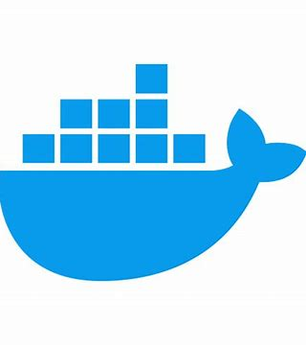
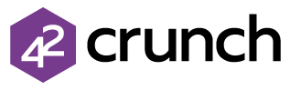
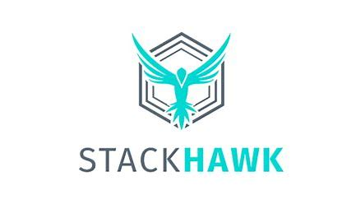





Defender for DevOps
Security by design
Secure Development
DevOps posture visibility
Code | Dependencies | Secrets | Container images | Infrastructure as code security insights
Infrastructure as code security
ARM | Bicep | Terraform | CloudFormation | And more
Microsoft Defender for Cloud
DevOps Security Management
Cloud Security
Posture Management
Cloud Workload Protection
Code to cloud contextualization
Across multipipeline and multicloud environments
…
Automated API Security Testing
API Security Testing | Proactively Fix API vulnerabilities
Integrated workflows
Pull request annotations | Developer ownership assignments
Powered by

Slide 5


Cloud security posture management
Configuration
Drift
App Hardening
Microsoft Defender for Cloud
Unify your DevOps security
Cloud Security
Posture Management
Cloud Workload Protection
…
Defender CSPM
Agentless vulnerability scanning
Visibility on software and CVEs | Disc snapshots | Insecure secrets and keys
Regulatory compliance and industry benchmarks
Over 50 standards | Multicloud Microsoft security benchmark | Compliance dashboard and reporting | Integration with Microsoft Purview compliance manager
Integrated data and insights
Defender for DevOps | Defender External Attack Surface Management | Entra Permissions Management | Defender for API
Governance management
Assign owners automatically | Drive accountability in the organization | Grace period | Reduce time to remediate
Contextual cloud security and risk prioritization
Attack path analysis | Intelligent cloud security graph | Custom path queries on cloud security explorer | Risk-based prioritization
Data-aware security posture
Multicloud data estate discovery | Identify data flows and resources containing sensitive
and shadow data | Uncover potential sensitive data exposure and data breaches
Harden API & AI Configurations and risk remediation
API & AI Hardening | risk prioritization
Classify and understand the security posture of APIs
Unified Inventory| Security Insights | Sensitive data classification

Slide 6

Cloud workload protection
Runtime protection
Real-time detection & response
Microsoft Defender for Cloud
Unify your DevOps security
Cloud Security
Posture Management
Cloud Workload Protection
…
Defender CWP/CDR
Threat detection
Prioritized alerts across compute, databases, the cloud service layer, and more
MITRE ATT&CK®framework mapping
Understand the effect across the adversary’s attack lifecycle
Leading threat intelligence
Rely on highly sophisticated and resource-specific alerts based on Microsoft’s global threat intelligence
Vulnerability management
Identify and remediate vulnerabilities before they are exploited
Alert correlation
Prioritize more easily with connected alerts that are grouped into incidents

Slide 7
























Cloud Workload Protection
Runtime protection
Real-time detection & response
Compute:
-
Any server
Azure VMSS
Azure K8s
App Services
Unmanaged K8s
Service layer:
Microsoft Defender for Cloud
Azure DNS
Key Vault
Network Layer V1
Resource Management
Unify your DevOps Security Management
Strengthen and manage your cloud security posture
Protect your cloud workloads
Databases and storage:
-
Blob storage
File storage
Maria DB
Cosmos DB
Azure SQL
MySQL
Postgres SQL
Unmanaged SQL
DevOps
…
CWP
AWS workloads:
CIEM
EASM
-
-
Amazon EKS
Amazon EC2
Unmanaged SQL
Unmanaged Kubernetes
GCP workloads:
-
-
GKE clusters
Google Compute
Unmanaged SQL
Unmanaged Kubernetes
On-premises
workloads:
Kubernetes
SQL Servers
Servers

Slide 8







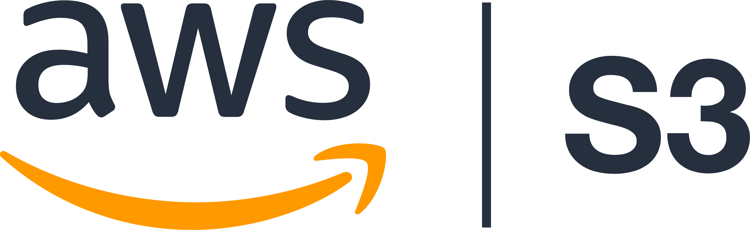

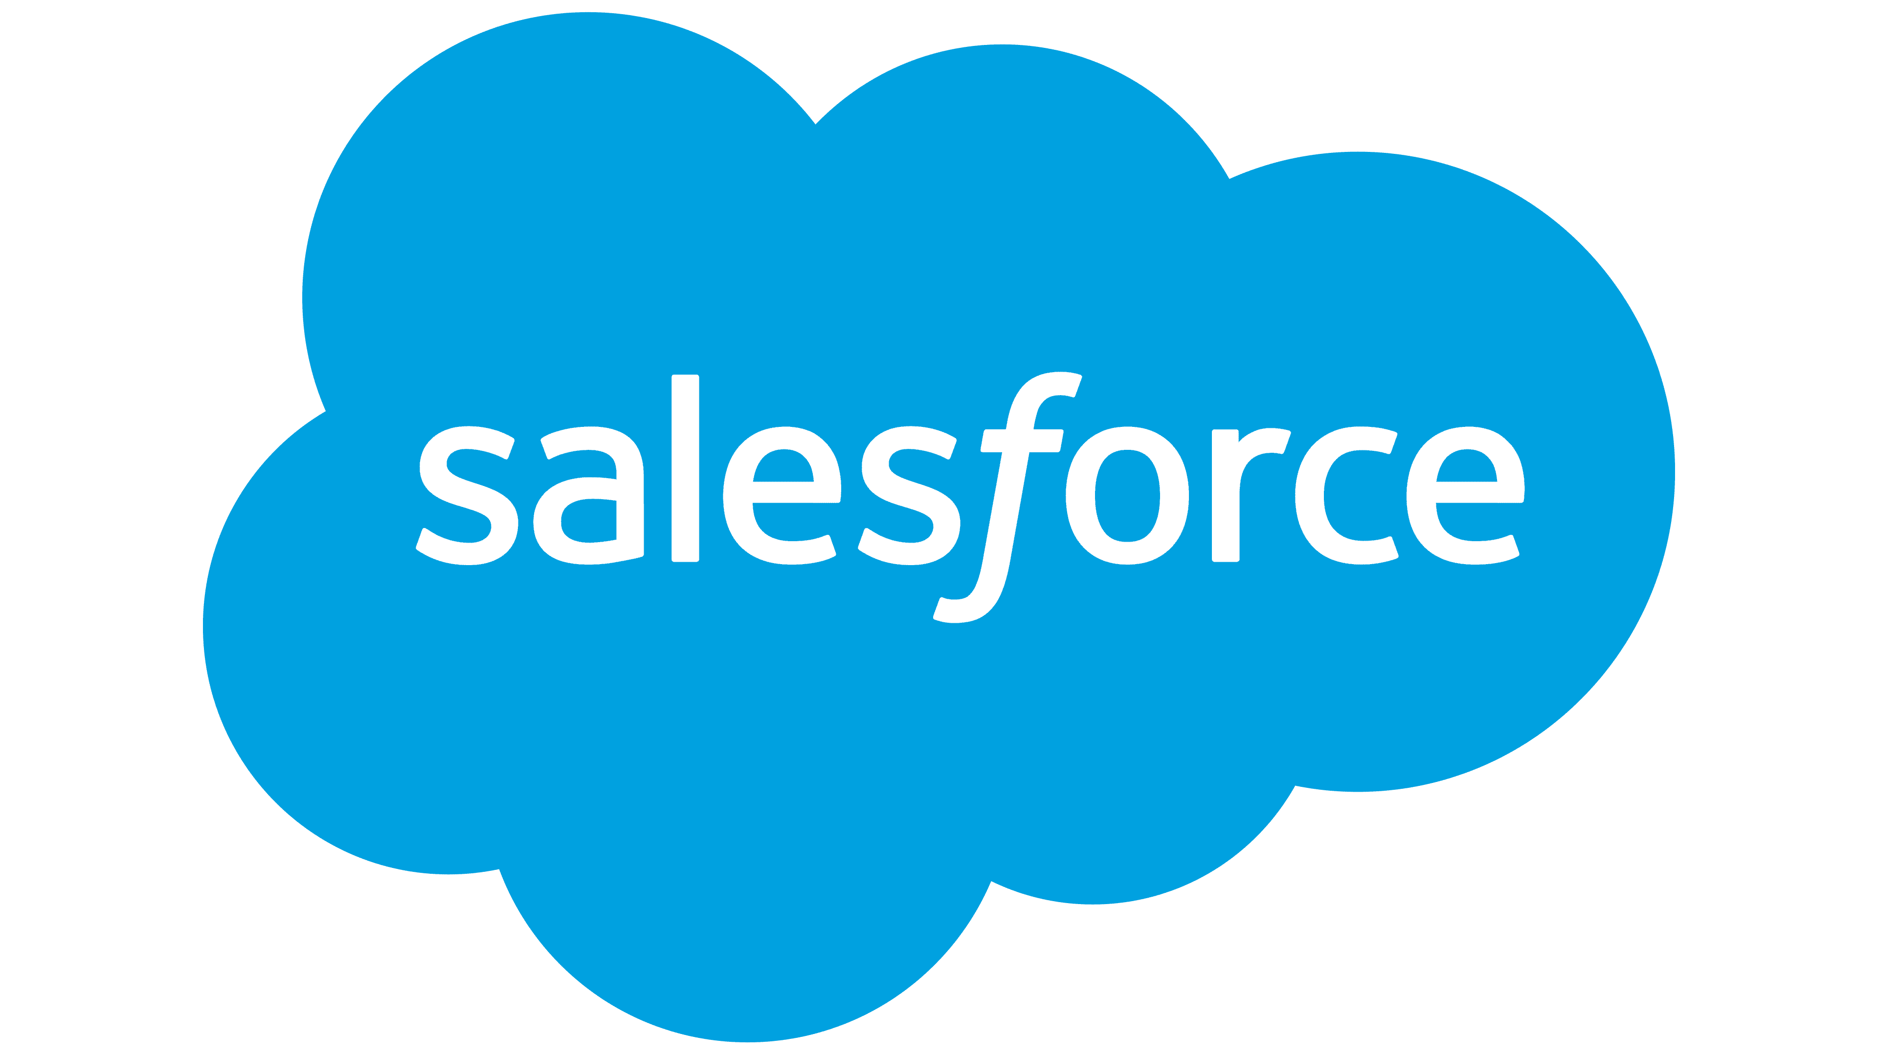
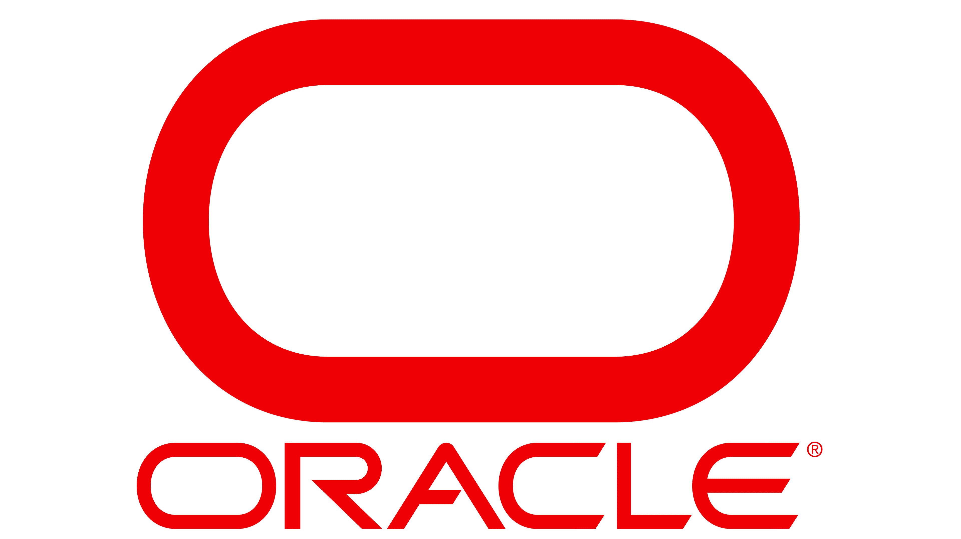
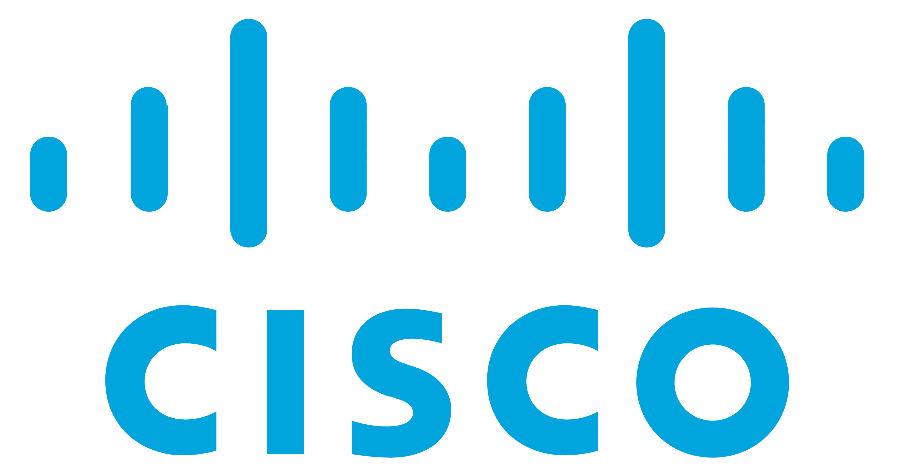

A unified security operations platform Microsoft Sentinel and Defender XDR together
Runtime protection
Real-time detection & response
300+ data sources including:
Prevent
Microsoft Security Copilot
Microsoft Threat Intelligence
CI/CD
Microsoft Azure
CI/CD
Google Cloud Platform
Detect
SIEM + XDR
Android
ServiceNow
CI/CD
Palo Alto
Investigate
CrowdStrike
Email and collaboration
Linux
Applications
Visibility across your entire organization, plus depth of protection across end users and infrastructure
Hybrid identities
Amazon Web Services
Cloud apps
Windows
Respond
SAP
macOS
Salesforce
Endpoints and IoT
Microsoft Security Experts Managed services offering

Users
Oracle
Cisco
Jira

Slide 9
Demo

Slide 10









The Silo Effect
Defenders must adapt to attacker’s mindset
Defenders think in lists
Attackers think in graphs
As long as this is true, attackers win

Slide 11


Extend posture management to the entire digital estate
CMDB
Vulnerability management
User
SaaS app
Attack surface management
Continuously discover, contextualize and manage an organization’s assets to provide defenders with an attacker perspective
Email security
Device
Identity security
User
Endpoint security
AWS S3
Input
Output
Attack path analysis
Prioritize weaknesses by considering the attacker's perspective, moving away from the traditional siloed approach
SaaS security
Application security
Device
Cloud workload
Cloud security
External attack surface
Container
Unified exposure insights
Understand your security posture and proactively answer questions from key stakeholders using out-of-the-box insights
IOT
Container
Threat intelligence
Risk Posture
Optimization
Security risk
Asset value
Business owner
Relationship
Attack path
Microsoft Defender for Cloud integration with Microsoft Security Exposure Management

Slide 12
Building an Exposure Management program with Microsoft stack
Identity Security Posture
Defender for Identity
Entra ID
Email Security Posture
Defender for Office
Vulnerability Assessment
Defender Vulnerability Management
Data Security Posture (DSPM)
Purview Data Security
Attack Surface Assessment
Defender External Attack Surface Management
Cloud
Security Posture (CSPM)
Defender for Cloud
Exposure Management
Microsoft Security Exposure Management
Threat
Intelligence
Defender Threat Intelligence
Application
Security Posture (ASPM)
Defender for Cloud
CMDB
Defender *
SaaS Security Posture (SSPM)
Defender for Apps
Endpoint Security Posture
Defender for Endpoint
Defender for IoT
Patch Management
Intune
Blue border products are pre-integrated in Exposure Management public preview
* Multiple products contribute to the asset inventory in Defender.

Slide 13


Unified open security operations platform Built to tackle the entire lifecycle of threats and streamline operations
Proactively improve posture and reduce attack surface
Microsoft Unified Incident Management
Microsoft Security Exposure Management
Existing security portfolio
External attack surface area
Microsoft Security Experts
Microsoft Threat Intelligence
Microsoft Copilot for Security
Depth of protection across end users and infrastructure
Microsoft Defender XDR
Defender for Cloud
Visibility across your cloud platforms
Microsoft Sentinel
Visibility across MSFT & non-MSFT event sources

Slide 14
Demo
Notes:
Link to demo: https://aka.ms/DefenderCSPM/Demo

Slide 15
Thank you Q&A

